Slide 1

Data Storytelling in Tableau for Different Audiences
Effective visualization techniques for varied viewer needs

Slide 2


Tailoring Data Stories from Executives to Front-Line Employees
Executive Data Storytelling
Executives need high-level insights with KPIs, trends, and clear summaries for strategic decisions.
Managerial Data Insights
Managers require detailed context with comparisons, breakdowns, and interactive filters to identify patterns.
Front-Line Data Focus
Front-line employees benefit from simple, actionable metrics focused on daily performance and tasks.
Notes:
When creating data stories in Tableau, it is important to tailor the message to match the knowledge level, goals, and time constraints of the audience. Executives typically need high-level insights that support strategic decision-making. For this audience, dashboards should focus on key performance indicators (KPIs), overall trends, and clear summaries rather than detailed data. Simple visuals such as line charts, bar charts, and scorecards work well because they allow executives to quickly understand the big picture without being overwhelmed. Clear titles and brief annotations help communicate the main takeaway briefly. Managers often sit between strategy and operations, so they benefit from more detailed context than executives but still need clarity and efficiency. For this group, Tableau dashboards can include comparisons over time, breakdowns by department or region, and filters that allow them to explore the data further. Visuals such as grouped bar charts, dashboards with interactive filters, and trend lines help managers identify patterns and potential issues that require action. Providing some explanatory text or tooltips can help clarify how the data should be interpreted. Front-line employees usually need very specific, task-focused information that directly relates to their daily work. For this audience, simplicity is key. Visualizations should avoid complexity and focus on clear, actionable metrics. For example, a front-line sales employee may only need to see daily targets versus actual performance. Using straightforward charts, consistent colors, and clear labels helps prevent confusion. By matching the complexity of the data story to the audience’s role and experience, organizations can ensure effective communication across all levels.

Slide 3

Creating Visually Engaging Yet Reliable Tableau Reports
Ensure Data Accuracy
Clean, validate, and update data before designing visuals to maintain report reliability and correctness.
Use Appropriate Charting
Select correct chart types and scales, such as starting bar charts at zero to avoid misleading views.
Clear Labels and Documentation
Include descriptive labels, legends, titles, data sources, and refresh dates to build audience trust.
Responsible Visual Design
Apply consistent color schemes and layouts while avoiding unnecessary decorations to enhance readability.
Notes:
One of the main challenges in data storytelling is balancing visually appealing dashboards with the need for accurate and reliable data. While attractive visuals can capture attention and improve engagement, they should never come at the expense of correctness. The priority should always be ensuring that the underlying data is clean, validated, and up to date before any visual design decisions are made. This includes checking for missing values, correcting errors, and confirming that calculations are accurate. In Tableau, accuracy can be supported by using appropriate chart types and scales. For example, starting axes at zero when using bar charts helps avoid misleading comparisons. Labels, legends, and titles should clearly explain what the data represents, and assumptions or limitations should be documented when necessary. Including data sources and refresh dates also builds trust with the audience by showing where the information comes from and how current it is. At the same time, good design principles can still be applied responsibly. Consistent color schemes, proper spacing, and logical layouts make dashboards easier to read without distorting the message. Avoiding unnecessary decorations, excessive colors, or overly complex visuals helps keep the focus on the data itself. By treating accuracy as the foundation and visual design as a supporting element, organizations can create Tableau reports that are both engaging and trustworthy.

Slide 4

Ethics and Responsibility in Tableau Visualizations
Honest Data Representation
Visualizations must accurately represent data without exaggeration or manipulation to ensure correct conclusions.
Transparency in Visualization
Communicate data limitations clearly using annotations, footnotes, or dashboard descriptions for viewer understanding.
Protecting Data Privacy
Ensure individual identities are protected by anonymizing data and following privacy policies in visualizations.
Notes:
Ethical considerations play a critical role in data storytelling and visualization. One of the most important ethical responsibilities is honesty. Visualizations should accurately represent the data without exaggeration, omission, or manipulation. For example, selectively showing only favorable data or using distorted scales to influence perception can lead to incorrect conclusions and poor decision-making. Transparency is another key ethical principle. Analysts should clearly communicate data limitations, such as small sample sizes, missing data, or assumptions used in calculations. This helps viewers understand the context and avoid overinterpreting the results. In Tableau, this can be done through annotations, footnotes, or dashboard descriptions. Privacy and confidentiality must also be protected, especially when working with sensitive or personal data. Analysts should ensure that individual identities cannot be inferred from visualizations, particularly in dashboards shared widely. Aggregating data, anonymizing identifiers, and following organizational data governance policies are essential practices. By prioritizing honesty, transparency, and privacy, data professionals can create ethical visualizations that support informed and responsible decision-making.

Slide 5
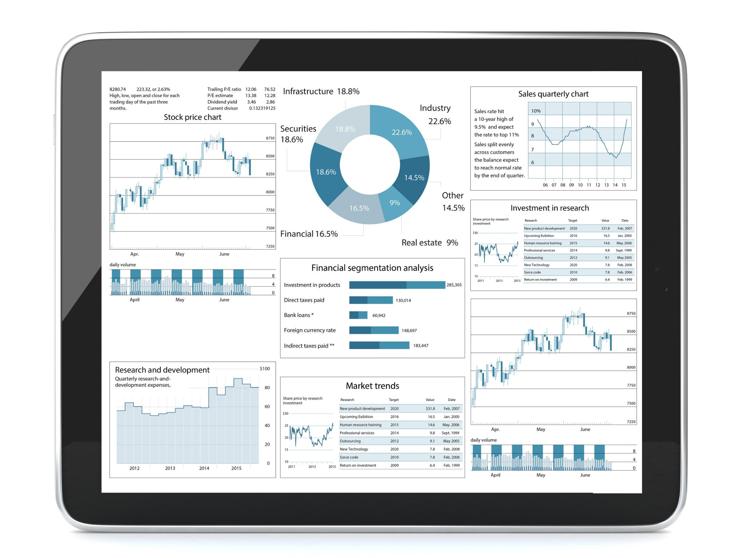
Strategies to Minimize Misinterpretation of Data
Consistency in Visualization
Using consistent chart types, colors, and terminology across dashboards increases user understanding and reduces confusion.
Providing Context
Clear titles, annotations, and tooltips explain trends and anomalies to ensure accurate interpretation of data visuals.
User Testing and Feedback
Testing dashboards with sample users uncovers unclear visuals and terminology, improving overall comprehension.
Notes:
Miscommunication is a common risk in data visualization, especially when audiences have different levels of data literacy. One effective way to minimize this risk is through consistency. Using consistent chart types, colors, and terminology across dashboards helps users quickly understand and compare information. For example, using the same color to represent a specific category throughout all visuals reduces confusion. Providing context is also essential. Titles should clearly state the main message of the visualization, not just describe the chart type. Annotations and tooltips can be used to explain trends, outliers, or unexpected results. In Tableau, interactive features such as filters and highlights should be intuitive and clearly labeled so users understand how their actions affect the data. Finally, testing dashboards with sample users before full deployment can greatly reduce misunderstandings. Feedback from executives, managers, or front-line employees can reveal unclear visuals or confusing terminology. Including brief explanations or data definitions within the dashboard can further support understanding. By focusing on clarity, consistency, and user feedback, data analysts and visualization experts can create Tableau data stories that communicate effectively and reduce the chance of misinterpretation.

